Slide 1
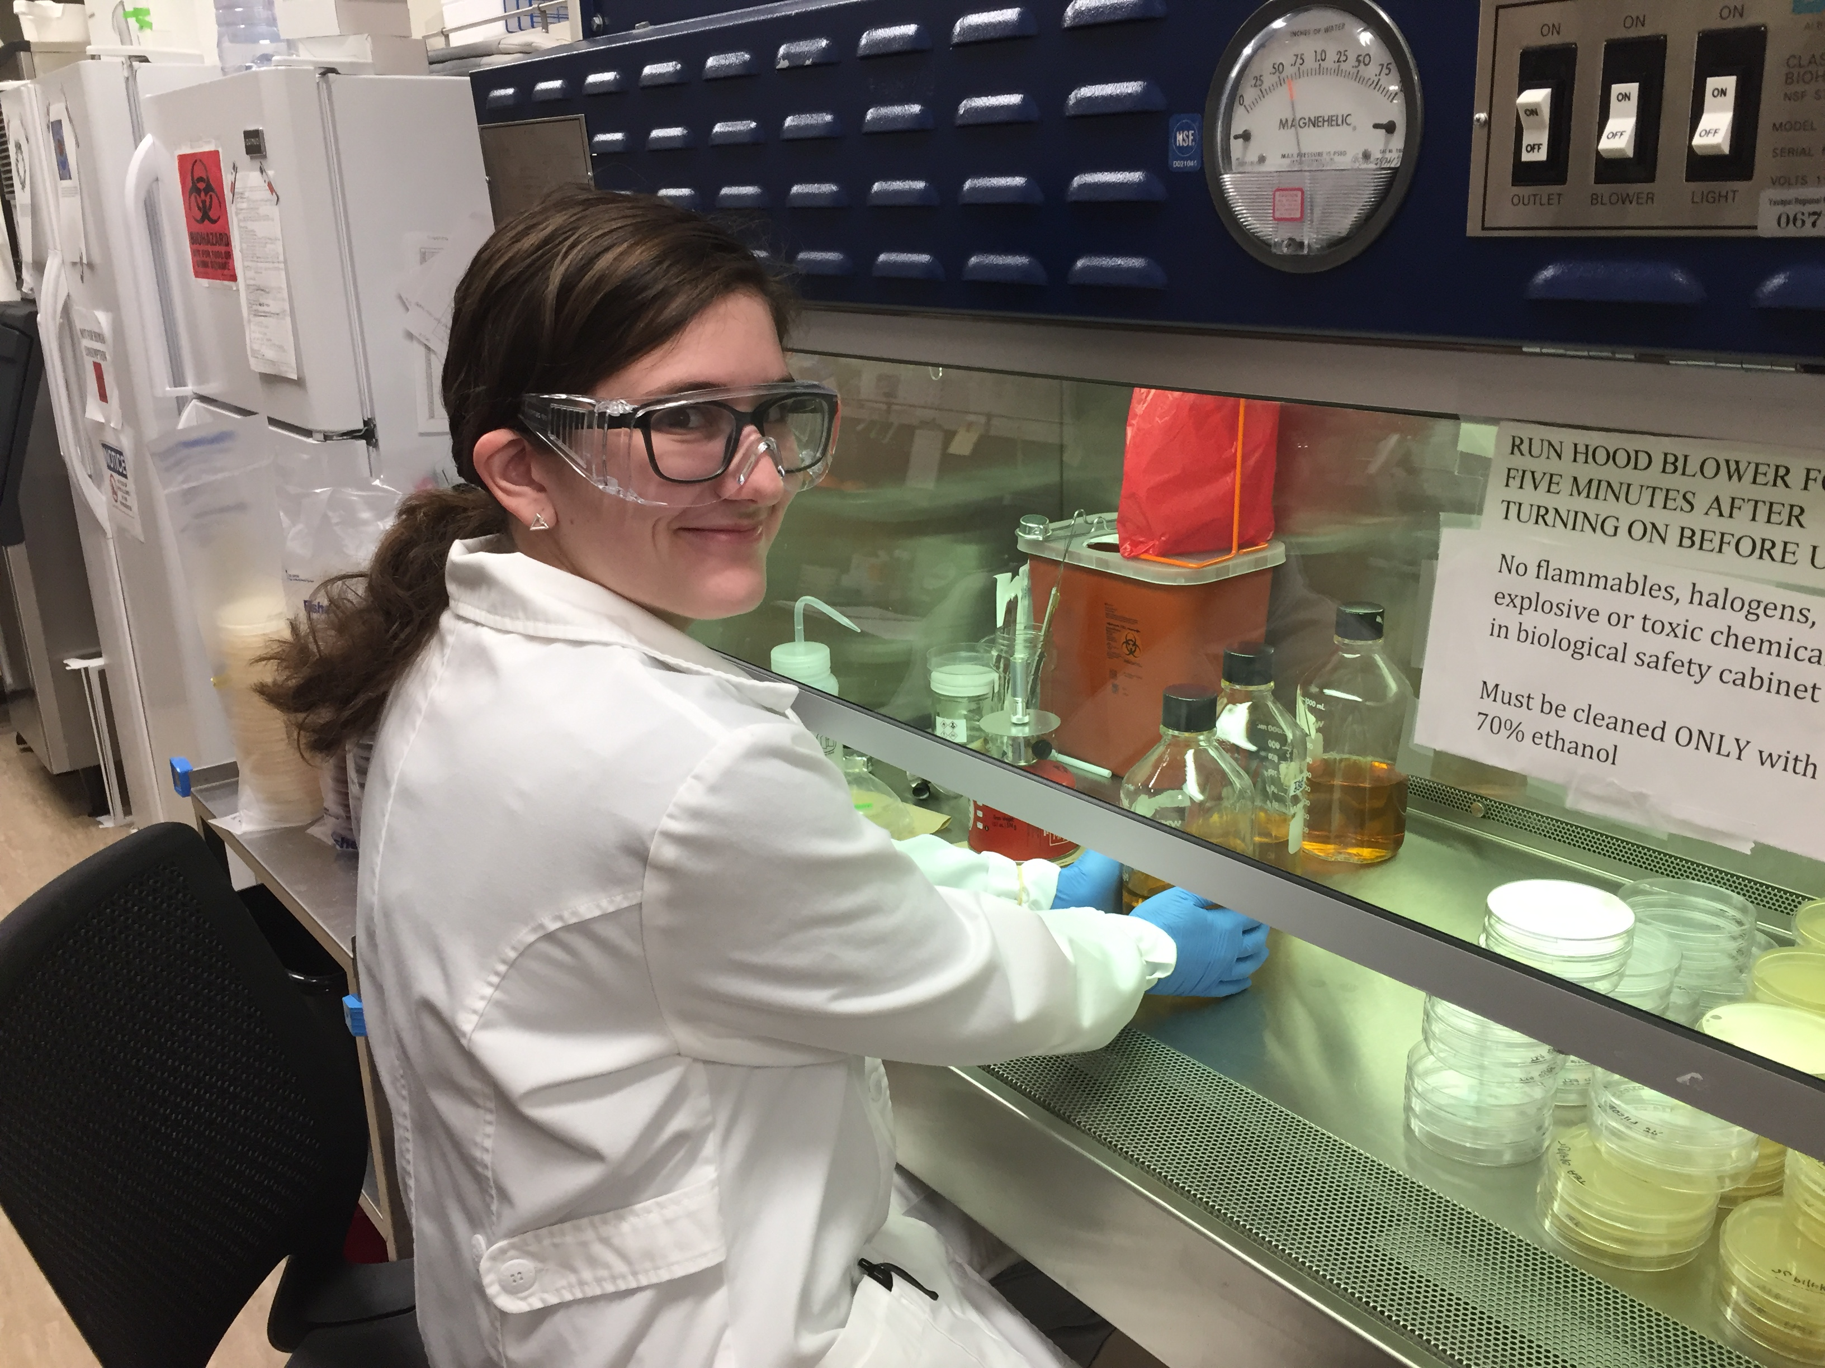
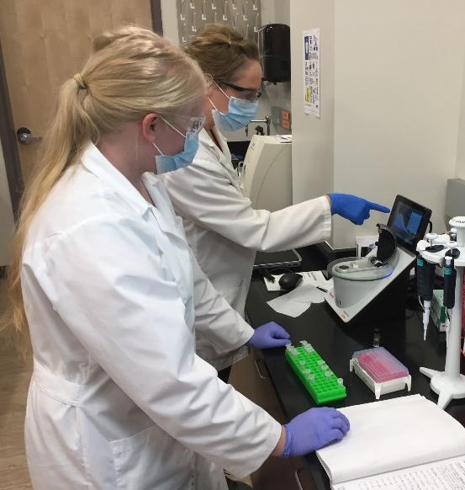
The future of biodiversity assessment: Using environmental DNA and next generation sequencing to characterize biological communities in the Central Highlands of Arizona
Bethany Davis and Courtney Turner-Rathbone
Project Mentors: Dr. Hillary Eaton, Dr. Katie Benson, and Matthew Valente

Slide 2



Acknowledgements
Dr. Hillary Eaton, Dr. Katie Benson, and Professor Matt Valente, Dept. of Biology and Chemistry, ERAU
Dr. Elliot Bryner, NASA Space Grant Program
Dr. Anne Boettcher, Undergraduate Research Institute

Slide 3
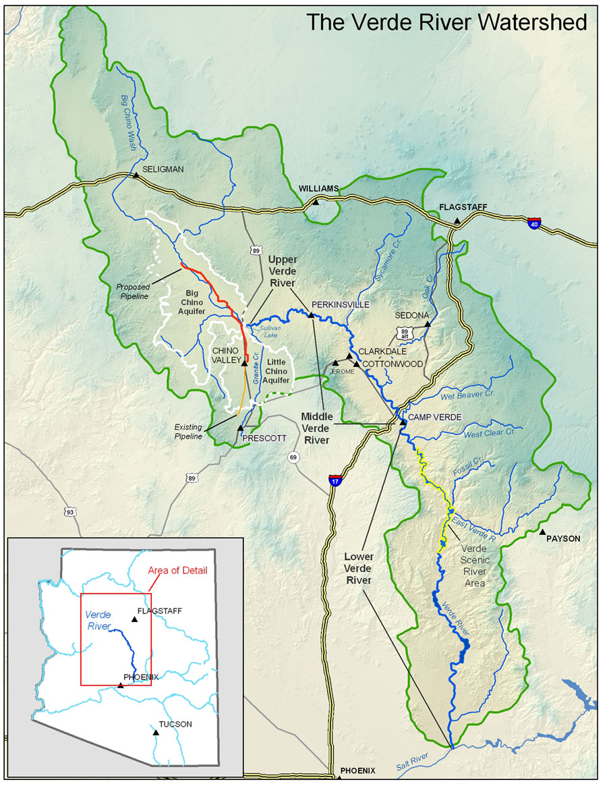
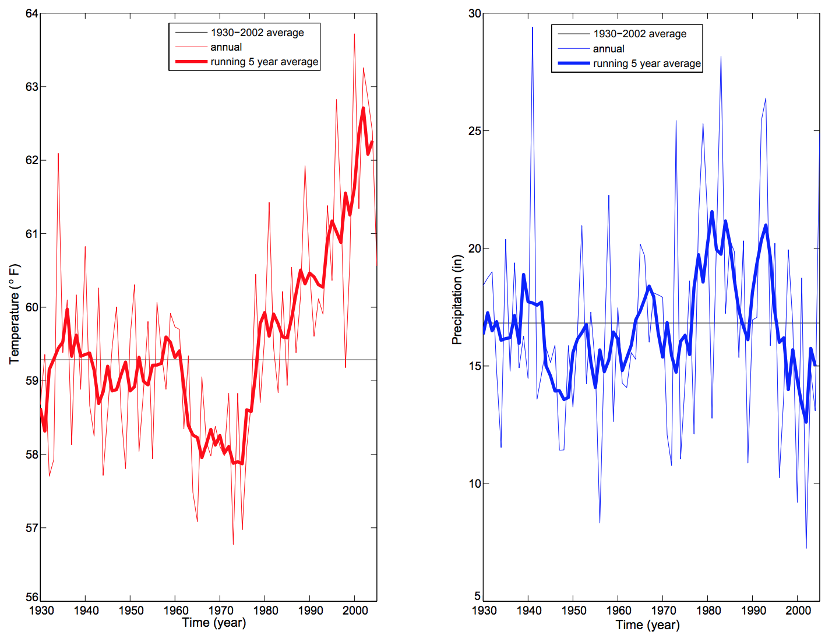
Environmental Monitoring
Central Highlands of Arizona
In transition zone
Riparian environments
(Arizona Department of Water Resources, 2014)
Notes:
Arizona Department of Water Resources. (2014). Central Highlands Planning Area Climate. Retrieved from http://www.azwater.gov/azdwr/StatewidePlanning/WaterAtlas/CentralHighlands/PlanningAreaOverview/Climate.htm
Graph shows the average temperature and precipitation from 1930-2002 in the Central Highlands, AZ

Slide 4
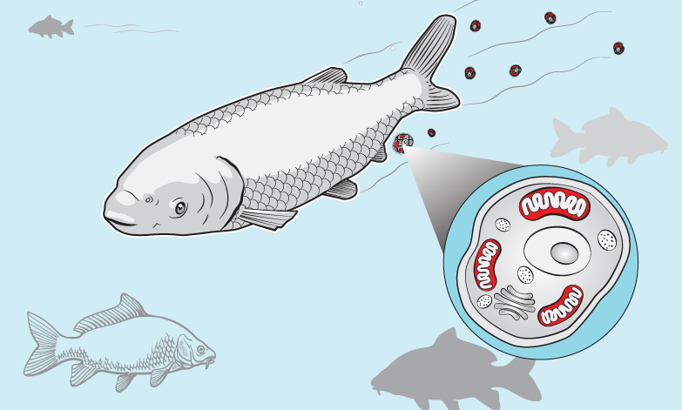
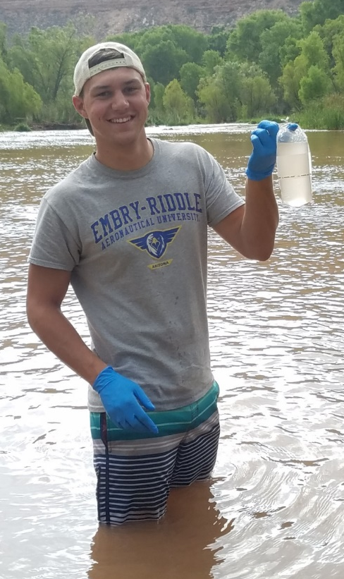
Environmental DNA (eDNA)
Organisms leave a genetic fingerprint in their environment

Slide 5
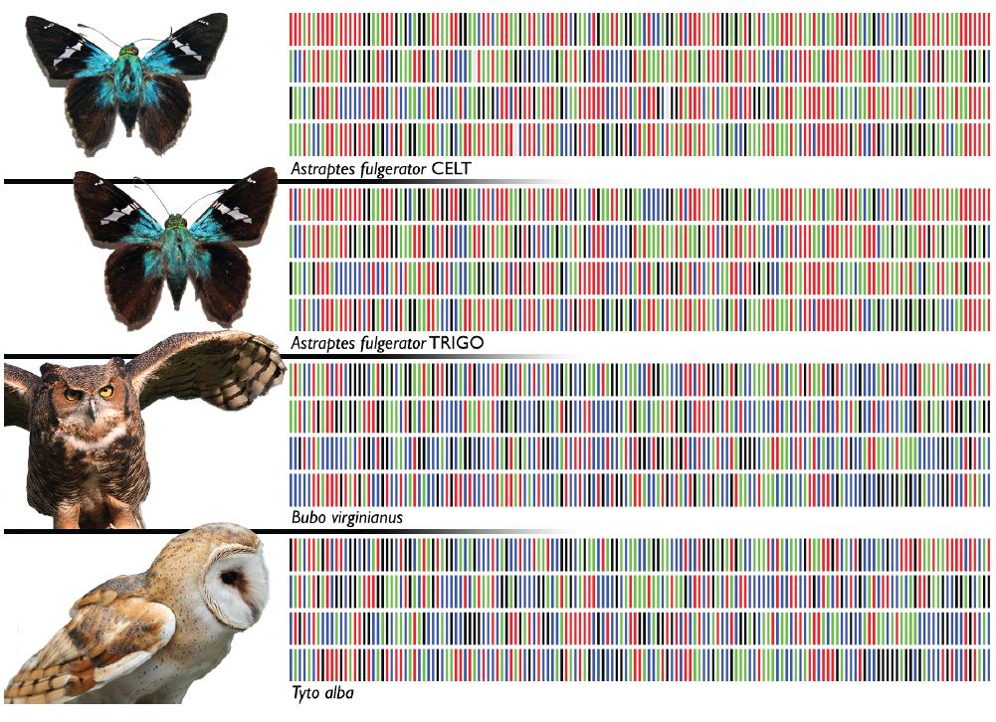
eDNA Analyses
Quantitative PCR (qPCR)
  Species-specific primers/probes to estimate amount of DNA
Metabarcoding
  Primers target entire taxonomic groups
  Next-generation sequencing

Slide 6
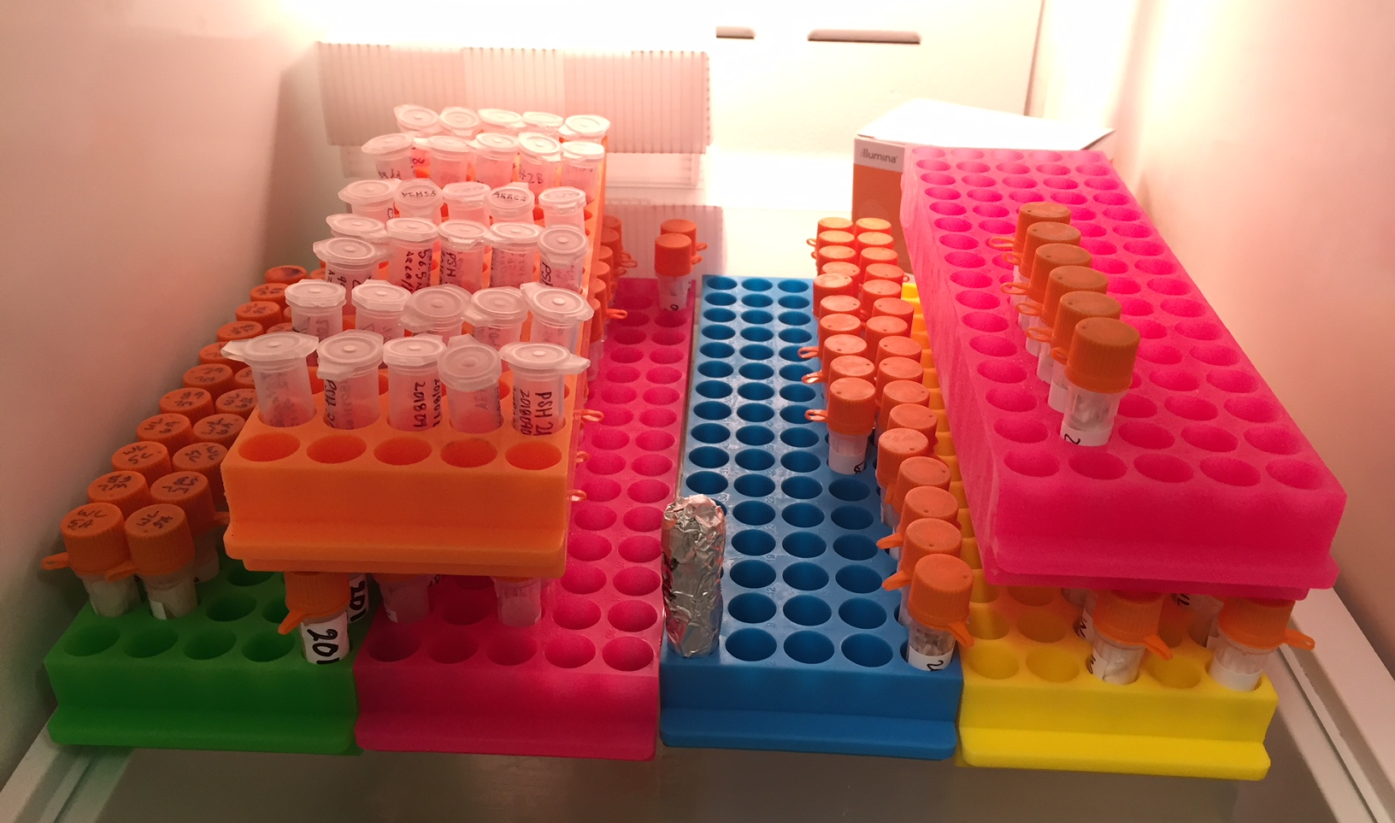
Advantages of eDNA
Detect multiple species
Less stressful
Survey time
Cost-effective
Detect rare species
Need a figure here

Slide 7
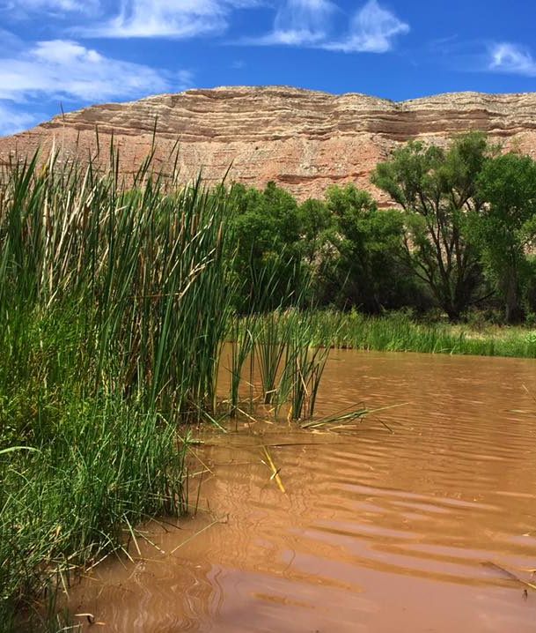
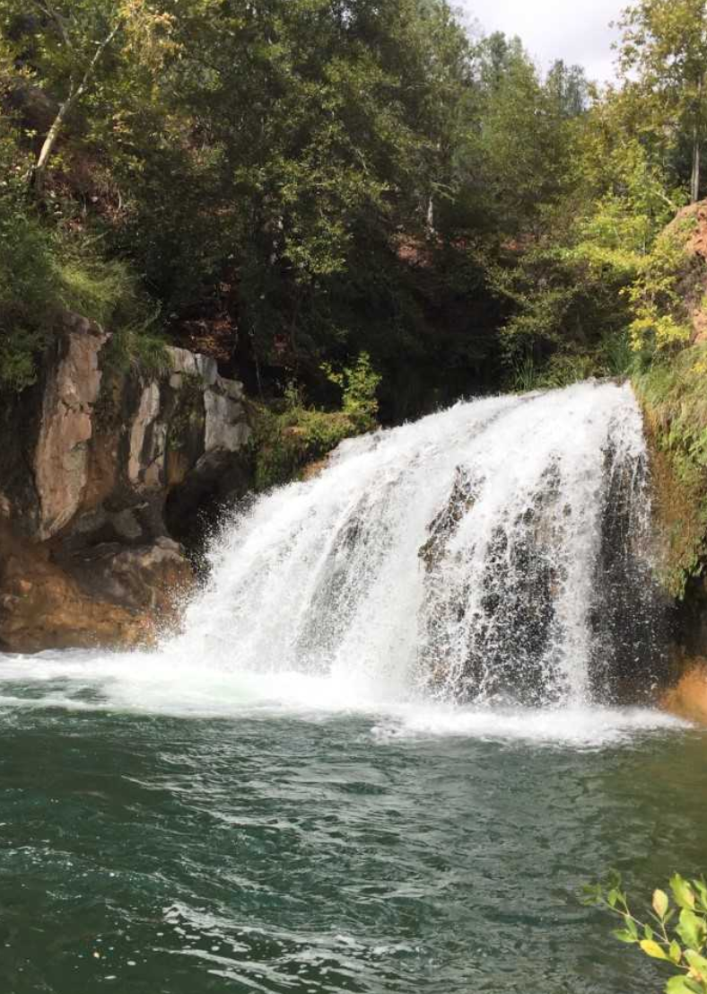
Current eDNA Research
Refined 16S rRNA metabarcoding protocol
Pilot studies on two rivers in Arizona
Verde River
Fossil Creek

Slide 8
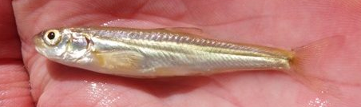
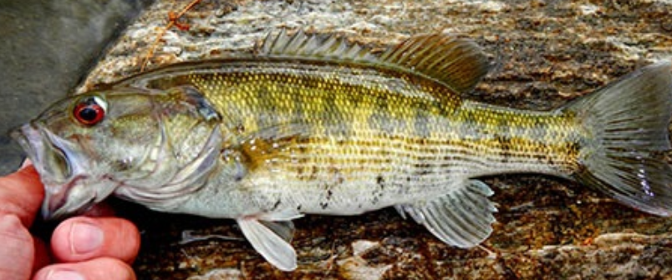
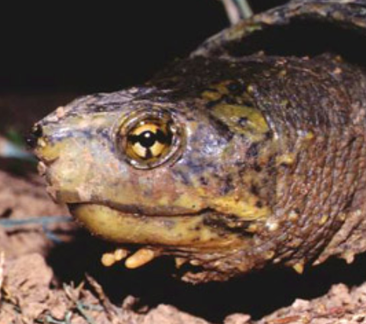
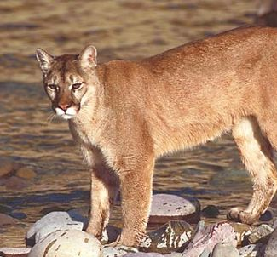
Current eDNA Research
Detected 41 vertebrates from 13 sites on Verde River and Fossil Creek
Taxa | Common Name | Scientific Name
Fishes | Longfin dace | Agosia chrysogaster
 | Desert Sucker | Catostomus clarkii
 | Sonora Sucker | Catostomus insignis
 | Spikedace | Meda fulgida
 | Redeye Bass | Micropterus coosae
 | Gila Topminnow | Poeciliopsis occidentalis
Amphibians | Canyon Treefrog | Hyla arenicolor
 | Lowland Leopard Frog | Rana yavapaiensis
Reptiles | Sonora Mud Turtle | Kinosternon sonoriense
Birds | Wood Duck | Aix sponsa
 | Common Yellowthroat | Geothylpis trichas
Mammals | Arizona Gray Squirrel | Sciurus arizonensis
 | Elk | Cervus elaphus
 | Mule Deer | Odocoileus hemionus
 | Mountain Lion | Puma concolor

Slide 9
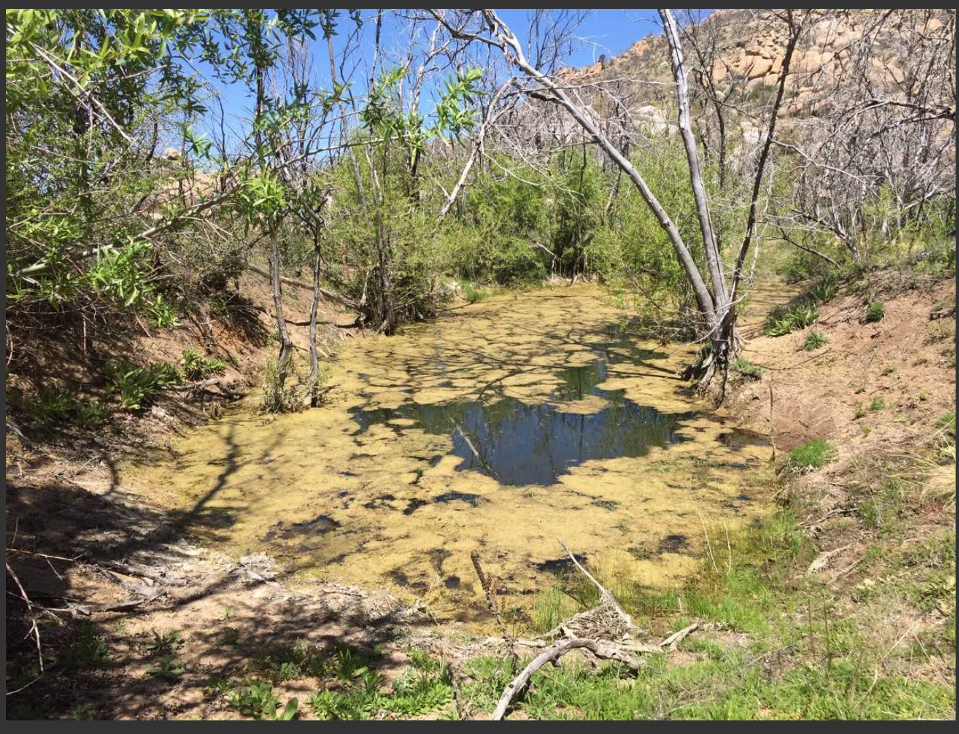
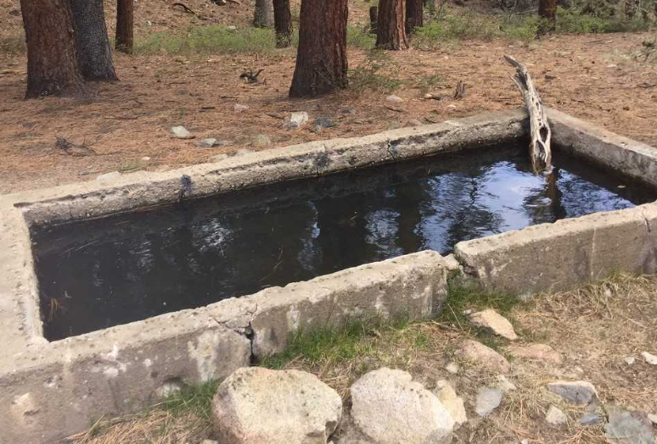
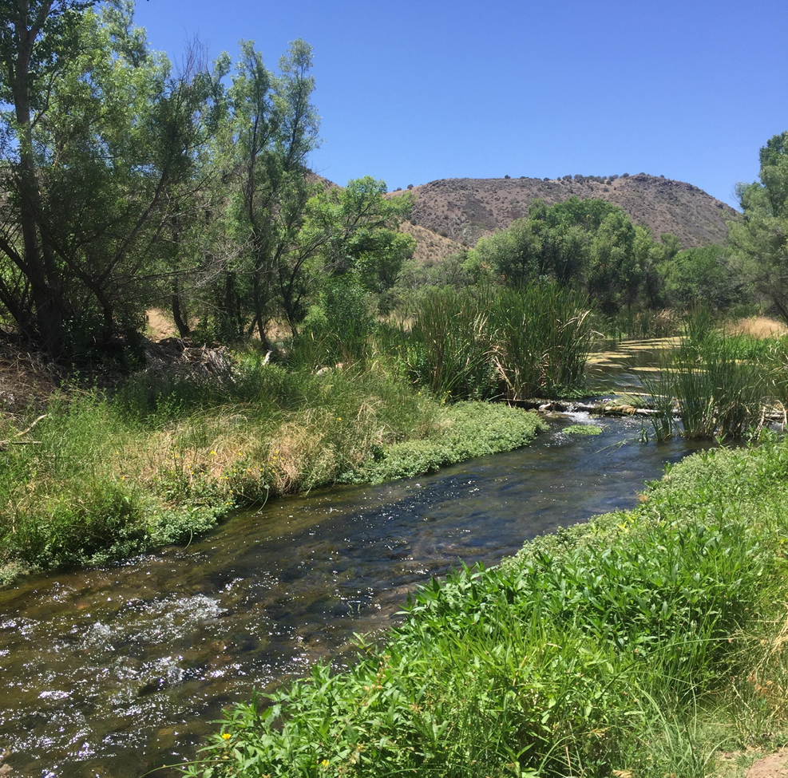
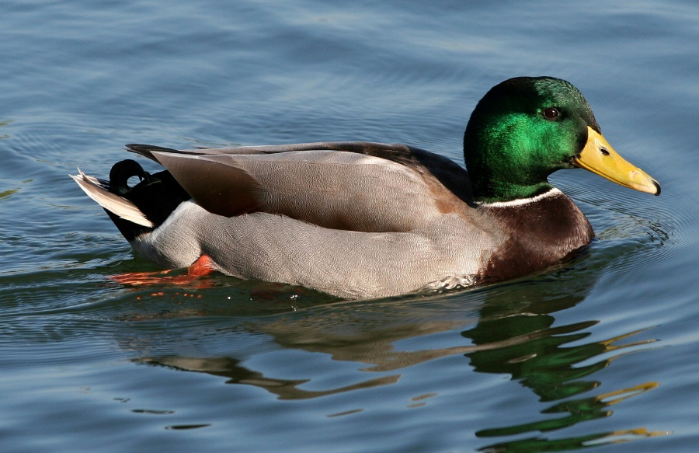
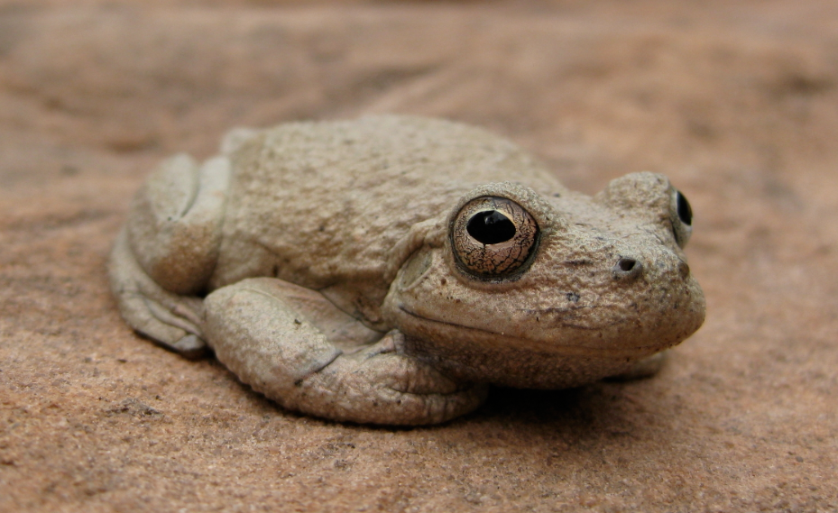
Future Projects

